Slide 1
IPV6
:: - FFFF:FFFF:FFFF:FFFF:FFFF:FFFF:FFFF:FFFF

Slide 2
IPv6
IPv6 is the “new” generation of IP addressing for the Internet, but it can also be used in small office/home networks
IPv6 was made due to shortages of IPv4 addresses.
IPv4 is 32-bit, IPv6 is 128-bit
IPv4 Max 4.2b addresses
IPv6 Max 340,282,366,920,938,463,463,374,607,431,768,211,456 addresses

Slide 3


Hexadecimal
Decimal | Hexadecimal
0 | 0
1 | 1
2 | 2
3 | 3
4 | 4
5 | 5
6 | 6
7 | 7
8 | 8
9 | 9
10 | A
11 | B
12 | C
13 | D
14 | E
15 | F
Hexadecimal contains numbers 0-9 and A-F

Slide 4
IPV6
Example IPv6 address: 2001:0000:0000:0001:20E4:0000:0000:000A
This takes too long to write, so here are some ways to shorten the address:
Remove leading zeroes
2001:0:0:1:20E4:0:0:a
Remove contiguous zeroes once
2001::1:20E4:0:0:A
OR 2001:0:0:1:20E4::A

Slide 5
IPv6 Subnets/prefixes
IPv6 has subnets just like IPv4, however a CIDR is always used instead of dotted decimal. (/24 instead of 255.255.255.0 etc.)
CIDR can also be called a prefix

Slide 6
Transmission types
Unicast – one to one
Multicast – one to many
Anycast – one to nearest/first/any (ANYONE HELP ME)
IPv4 has Unicast, Multicast and Broadcast

Slide 7
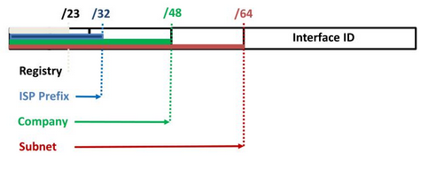
IPV6 address types
Global Unicast address
Looks like this: 2000::/3 (2000-3FFF)
Similar to public IPv4 address

Slide 8
Link-local address
Similar to IPv4 APIPA address, not routable across the Internet.
Windows devices assigns these automatically.
In IPv6 you can have both a link-local address and a global unicast address on one interface at the same time
Link local addresses begin with FE80::/10

Slide 9
Different IPV6 addresses
Unique local addresses – same thing as private addresses in ipv4
FC00::/7
Multicast address
FF00::/8
Loopback address
0000:0000:0000:0000:0000:0000:0000:0001
::1

Slide 10
Summary
Address type | Range
Global unicast | 2000::/3
Link-Local | FE80::/10
Unique Local | FC00::/7
Multicast | FF00::/8
Loopback | ::1/128

Slide 11
Stateless address auto-configuration
Uses something called Extended Unique Identifier (EUI-64) to generate and assign an unique IPv6 address.
To be able to generate this address, the device needs the network prefix from the router, and then it uses its own MAC address to create its own IPv6 address.
Contacts the router using a Router Solicication to get the network prefix
The router doesn’t know what IPv6 the devices assign themselves (hence classless), so to avoid duplicate addresses, the devices use a feature called Duplicate Address Detection (DAD), which is very similar to ARP.

Slide 12
Stateful configuration using dhcpv6
Very similar to IPv4 DHCP
The DHCP keeps track of all the addresses on lease, so this is a stateful configuration.

Slide 13
Interoperability with ipv4
IPv4 is still more in use than IPv6, so there needs to be ways for these to work together.
Dual stack – NIC that can support and process IPv4 and IPv6 traffic simultaneously. (needs an IPv4 + an IPv6 addr.)

Slide 14
Interoperability IPv4-IPv6
ISATAP
6to4
Teredo
Allows transmission of IPv6 data across an IPv4 network
Does not require multicast
Allows devices on separate IPv6 networks to communicate with eachother across an IPv4 network
Requires supporting infrastructure, such as 6to4 routers and a public IPv4 address for each endpoint
Similar to 6to4, but it also works on a network that uses NAT
Uses UDP for encapsulation.

Slide 15
Shorten these IPv6 addresses
2001:0052:0ABC:0000:0000:0000:FA10:0012
2001:ABCD:FA33:2354:1000:1230:8888:9320
2001:0000:0000:FFFE:0000:0000:FA20:0009

Slide 16
Name resolution
Domain Name System
Hosts file
WINS

Slide 17
DNS – Domain Name system
The Domain Name System (DNS) is a worldwide service that resolves host names (FQDN) to IP addresses.
This ensures proper communication between computers. DNS servers can ask a different DNS server if they can’t resolve the IP.
DNS uses port 53.

Slide 18
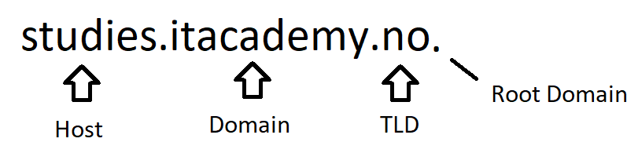
FQDN
You most likely use these daily
Easier way (for humans) to identify a host or service
Split in 4:
Host
Domain
TLD
Root Domain

Slide 19
Host
Can be anything, often given a relevant name for the service provided
Studies.itacademy.no
www.itacademy.no
Dc-01.itacademy.no

Slide 20
Domain
The domain part of a FQDN has to be registered with a «domain name registrar».
https://domene.shop
Example : «www.youtube.com»
Can have multiple sub domains
www.gaming.youtube.com

Slide 21
Top-level domain (TLD)
Controlled by «Internet Corporation for Assigned Names and Numbers (ICANN)
3 Categories:
Country code – two letter domain name that reflects the country of origin. (.no or .se)
Sponsored TLD – reflects the community that they represent (.edu – education, .gov government etc.)
Unsponsored TLD – These don’t represent any form of community (.com, .org)

Slide 22
Root domain .
We don’t need to add the root domain in the link “.”
Refers to the 13 root domain servers on the internet
Its job is to hold all the names and IP addresses of the top-level domain

Slide 23
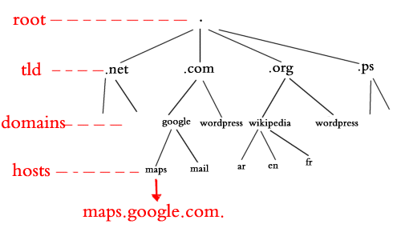
Hierarchy

Slide 24
DNS records
A DNS server has 3 ways of obtaining records
Manual entry – an administrator manually creates the record
Dynamic entry – Dynamic… requires an os that can register its IP and hostname automatically (Windows)
Zone transfer – Records updated from main DNS server to secondary.

Slide 25
DNS record types
A records – resolves FQDNs to IPv4 addr.
AAAA records – resolves FQDN to IPv6 addr.
NS records – contains name servers in a domain
MX records – contains mail servers
SRV records – contains devices that offers a services, (domain controller)
SOA records – contains name of primary DNS server + serial number
PTR record – resolves IPv4 to FQDN
CNAME – alias, resolves a FQDN to a hostname

Slide 26
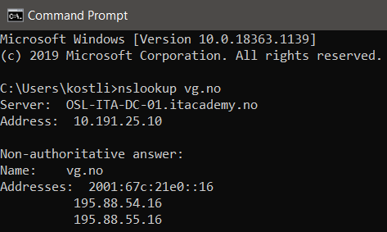
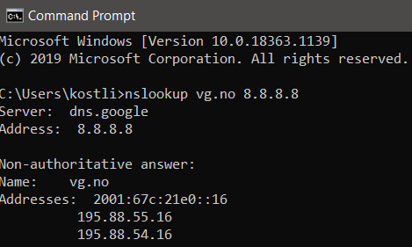
nslookup
Nslookup is a very useful windows troubleshooting tool.
Can easily see if a FQDN is being resolved
Can also specify which DNS server to use to resolve FQDN
Another useful command when troubleshooting DNS is ipconfig /flushdns

Slide 27
Hosts file
The hosts file is a file in Windows that provides a way of resolving host names locally (only resolves for the machine that has that hosts file)
The hosts file is checked before the devices sends a DNS query.
The host file is located in %systemroot%\System32\drivers\etc\
Can be edited with notepad (as admin)
Mostly used to prank coworkers by resolving vg.no to various triple x sites

Slide 28
wins
WINS resolve names (NetBIOS) to IP addresses
Doesn’t include domain, so it doesn’t work on the internet
Very outdated, no reason to use this since DNS is a thing

Slide 29
DHCP
Used to automatically provide IP addresses to Clients
Also includes information on gateway, DNS and WINS
DHCP can be configured on Windows server, nearly all l3 networking device and many other devices.
DHCP process can be defined in 4 steps (DORA):
Discover – client (that needs an IP) sends a broadcast to discover the DHCP server
Offer – DHCP server offers an IP address to the client
Request – The client accepts the offer, sends that information back to DHCP server
Acknowledge – The server responds, OK you can have that IP.

Slide 30
More DHCP options
When configuring DHCP, you have many options, some of these are:
IP address range - scope that the clients gets an IP from (10.0.0.10 – 10.0.0.100 etc.)
DHCP exclusions – An exclusion in the scope.
Example, 10.0.0.15 is excluded because this IP is statically assigned to a switch. This is done to prevent that IP to be assigned to another device. Duplicate IP = bad
DHCP Lease – This is for how long a device can keep an IP provided by DHCP
DHCP Reservation – Used to reserve an IP to a particular device. (reserved by using MAC addr.)
Often used for printers, so they always have the same IP.

Slide 31
Whitelist/blacklist
Whitelist = allow
Blacklist = deny
Since 2020, this is now offensive, and is often referred to as allow-list and deny-list.

Slide 32
Windows troubleshooting commands
Ping 8.8.8.8 – ICMP protocol, used to test connectivity.
Tracert 8.8.8.8 – Same as ping, except this shows each hop (router) on the way to the destination
Netstat – displays active ports your computer is listening to
Route print – check routing table on Windows device
Arp – checks arp table
Nslookup – used to troubleshoot DNS, test if FQDN is being resolved

Slide 33
